Slide 1


Security Analysis of Access Control Policies for Smart Homes
University
of Molise
Roberta Cimorelli Belfiore, Anna Lisa Ferrara
University of Molise,
Italy
SACMAT2023

Slide 2
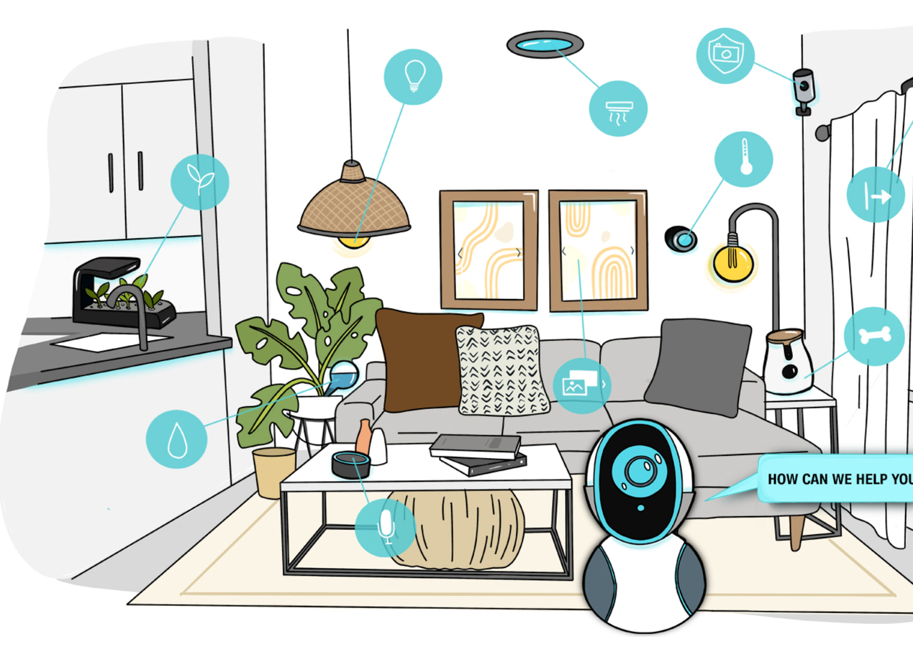
University
of Molise
Introduction
Smart houses are becoming increasingly common due to the IoT, but protecting privacy and resources is a concern.
To address this issue, sophisticated access control specifications and enforcement models are needed.

Slide 3
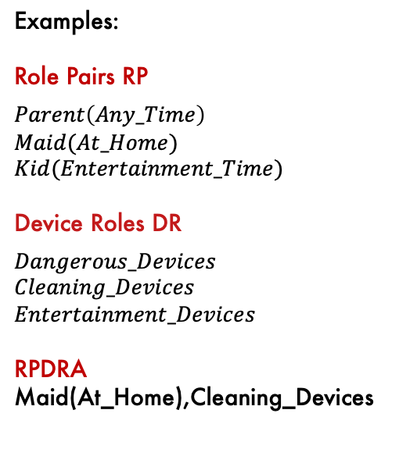
University
of Molise
State of the art: EGRBAC
Examples:
Role Pairs RP
$$Parent\left(Any_Time\right)$$
$$Maid(At_Home)$$
$$Kid(Entertainment_Time)$$
Device Roles DR
$$Dangerous_Devices$$
$$Cleaning_Devices$$
$$Entertainment_Devices$$
RPDRA
Maid(At_Home),Cleaning_Devices
UA
RPRA
ROLE PAIRS (RP)
RPDRA
DEVICE ROLES (DR)
PDRA
DEVICES (D)
USERS (U)
ROLES (R)
RPEA
OPERATIONS (OP)
ENVIRONMENT ROLES (ER)
PERMISSIONS (P)
S. Ameer, J. Benson and R. Sandhu, "The EGRBAC Model for Smart Home IoT," 2020 IEEE 21st International Conference on Information Reuse and Integration for Data Science (IRI), 2020, pp. 457-462.

Slide 4
University
of Molise
State of the art: Administrative EGRBAC
USERS (U)
UA
ROLES (R)
RPRA
ROLE PAIRS (RP)
RPDRA
DEVICES ROLES (DR)
PDRA
DEVICES (D)
Authorization Functions:
AssignRPDR
RevokeRPDR
Operational model
RPEA
OPERATIONS (OP)
URA-ARBAC
ENVIRONMENT ROLES (ER)
PERMISSIONS (P)
Administrative model
ADMINISTRATIVE ROLES (AR)
Shakarami Mehrnoosh, and Ravi Sandhu.
"Role-based administration of role-based smart home IoT." Proceedings of the 2021 ACM Workshop on Secure and Trustworthy Cyber-Physical Systems. 2021.

Slide 5
University
of Molise
State of the art: Administrative EGRBAC
USERS (U)
UA
ROLES (R)
RPRA
ROLE PAIRS (RP)
RPDRA
DEVICES ROLES (DR)
PDRA
DEVICES (D)
Authorization Functions:
AssignRPDR
RevokeRPDR
Operational model
RPEA
OPERATIONS (OP)
URA-ARBAC
ENVIRONMENT ROLES (ER)
PERMISSIONS (P)
Administrative model
ADMINISTRATIVE ROLES (AR)
Shakarami Mehrnoosh, and Ravi Sandhu.
"Role-based administration of role-based smart home IoT." Proceedings of the 2021 ACM Workshop on Secure and Trustworthy Cyber-Physical Systems. 2021.

Slide 6
University
of Molise
State of the art: Administrative EGRBAC
USERS (U)
UA
ROLES (R)
RPRA
ROLE PAIRS (RP)
RPDRA
DEVICES ROLES (DR)
PDRA
DEVICES (D)
Authorization Functions:
AssignRPDR
RevokeRPDR
Operational model
RPEA
OPERATIONS (OP)
URA-ARBAC
ENVIRONMENT ROLES (ER)
PERMISSIONS (P)
Administrative model
ADMINISTRATIVE ROLES (AR)
Shakarami Mehrnoosh, and Ravi Sandhu.
"Role-based administration of role-based smart home IoT." Proceedings of the 2021 ACM Workshop on Secure and Trustworthy Cyber-Physical Systems. 2021.

Slide 7
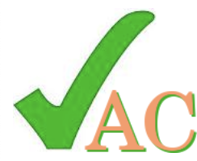
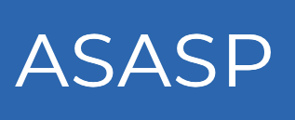

University
of Molise
Importance of Automated
Security Analysis
Mistakes are common and may result in security breaches.
Verification is essential
Policies are difficult to inspect by hand
An important aspect of security analysis is undoubtedly the ability to automate it.

Slide 8
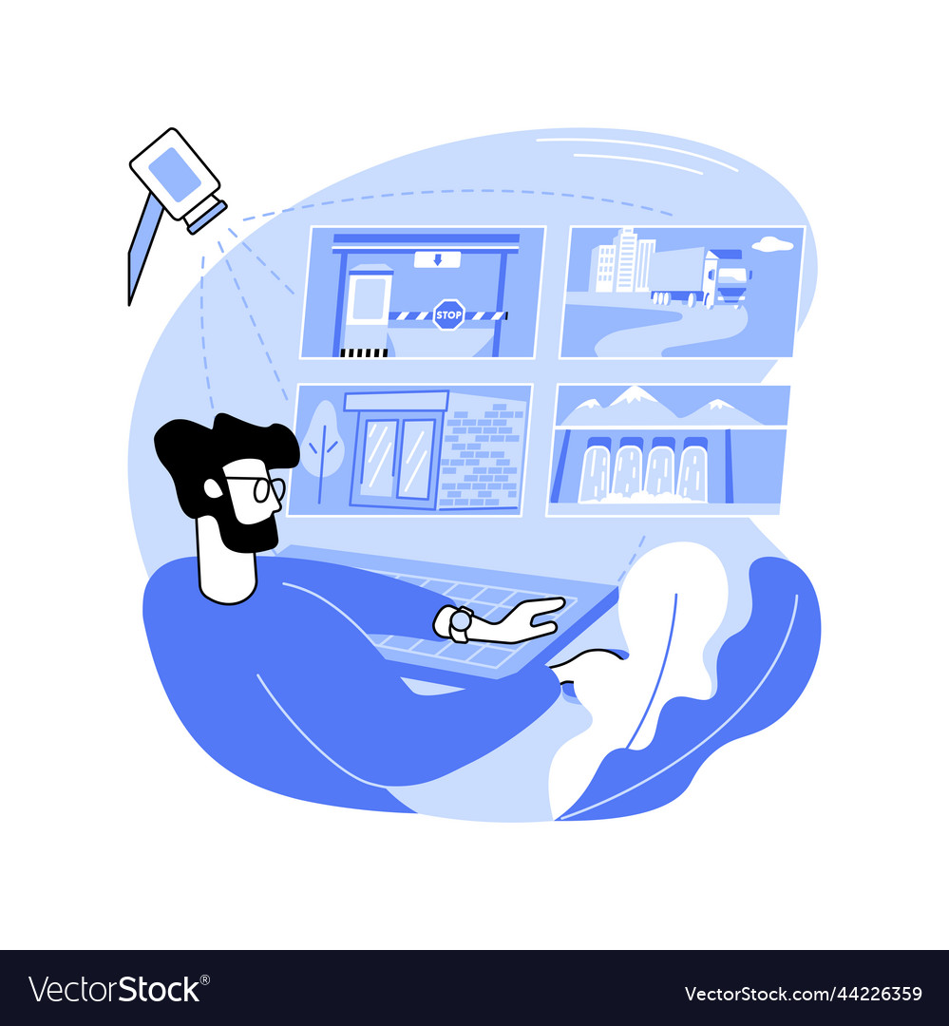
University
of Molise
Goal
Automated security analysis in Administrative EGRBAC
Realistic case study

Slide 9


University
of Molise
Authorization functions
AssignRPDR(AUser, AR, RP, DR)
RevokeRPDR(AUser, AR, RP, DR)

Slide 10
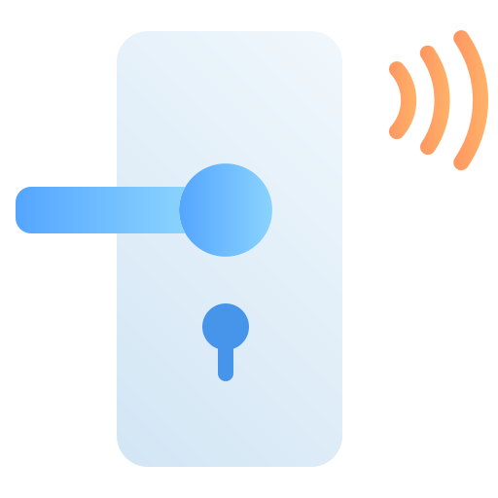


University
of Molise
Conditioned Assignment function
Sometimes homeowners need to establish policies that enable the assignment of role pairs to device roles based on their association with other device roles

Slide 11
University
of Molise
Conditioned Assignment function
We include preconditions for assignment actions, following ARBAC97's paradigm
AssignRPDR(AUser, AR, RP, precondition, DR)
AssignRPDR(Roberta, Home_Owner, maid_AtHome, Door_Device, Cleaning_Devices)

Slide 12
University
of Molise
Example of AEGRBAC policy
Admins: Home_Owner, Adult_Manager, Entertainment_Manager,…
Assign Rules
- AssignRPDR( Home_Owner, maid_At_Home, Door_Device, Cleaning_Devices )
- AssignRPDR( Adult_Manager, guest_At_Home, true, Lighting_Devices)
- AssignRPDR( Entertainment_Manager, kid_Entertainment_Time,
¬Entertainment_Devices, Kids_Friendly_Content)
…
Revoke Rules
- RevokeRPDR(Home_Owner, maid_At_Home, Cleaning_Devices )
- RevokeRPDR(Adult_Manager, guest_At_Home, Lighting_Device)
…

Slide 13
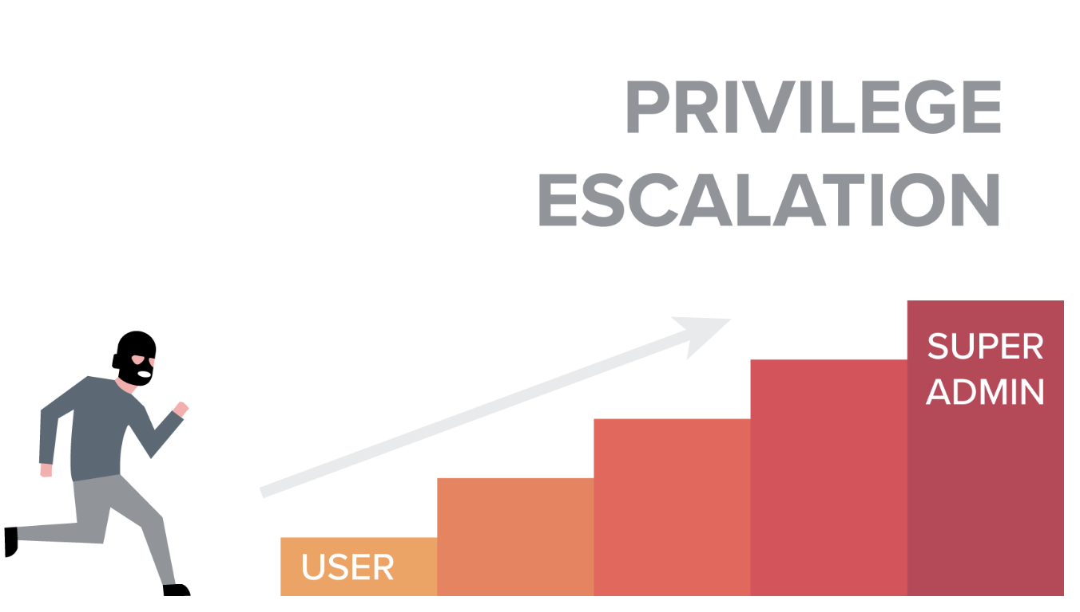


University
of Molise
Security Requirements
Homeowners design administrative policies to achieve specific security goals:
Privilege escalation: ensuring that no role pair has unauthorized access to devices
Availability: ensuring that a role pair has the necessary devices

Slide 14
University
of Molise
DR - reachability problem
- availability
- escalation of privileges
- …
each reduces to
DR-reachability Problem
Can any role pair gain access to a given device-role goal using the AEGRBAC rules?

Slide 15


University
of Molise
DR - reachability problem
$AssignRPDR$ or
$$RevokeRPDR$$
i
i+1
AEGRBAC System S
goal
Initial state

Slide 16

University
of Molise
Our approach
Step 1:
Reduction to role reachability problem in ARBAC
Step 2:
Automatic analysis using existing tools

Slide 17


University
of Molise
Our approach
Step 1:
We reduce the DR-reachability problem to the role-reachability problem in URA-ARBAC
$assign$ or
$revoke$ users to/from roles
j
j+1
ARBAC
role target

Slide 18
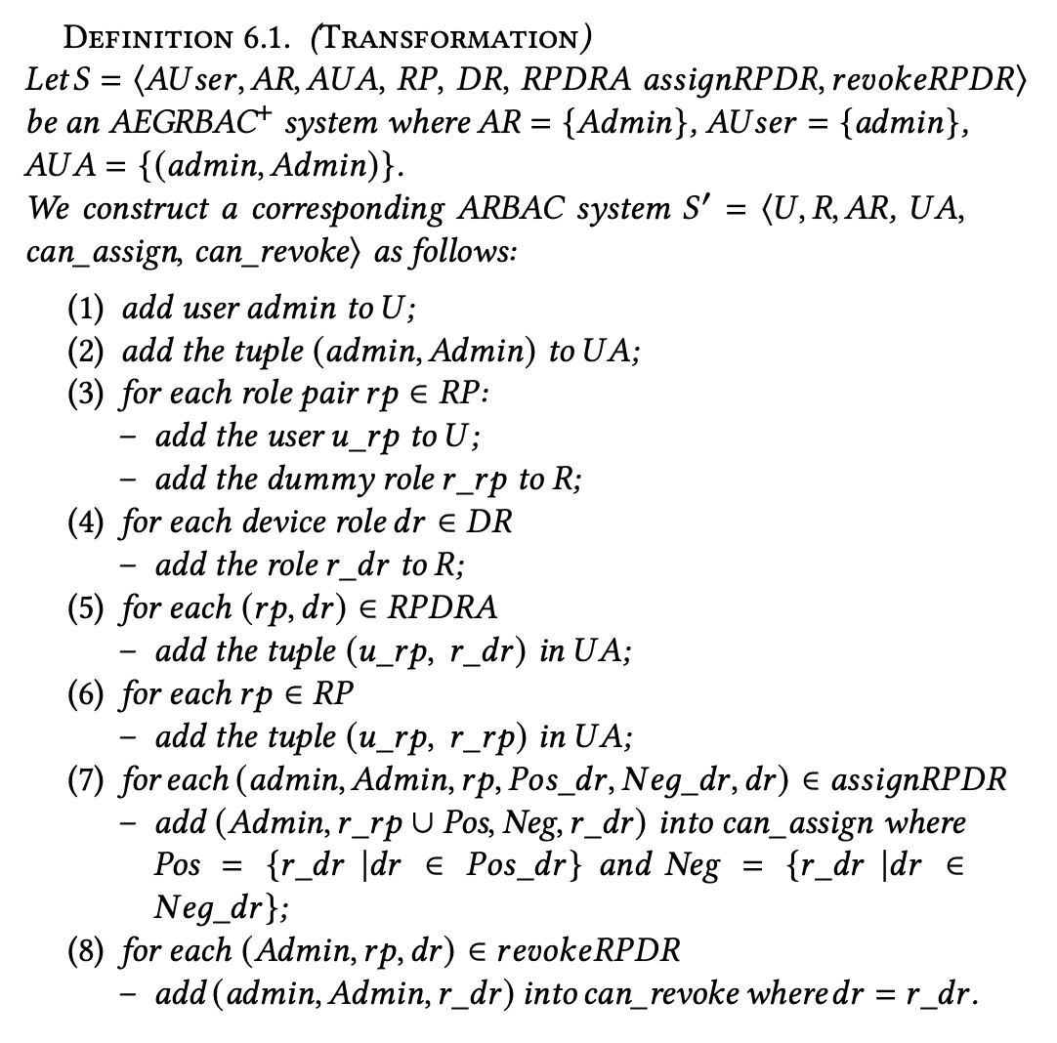




University
of Molise
Reduction
We don’t take into account AUser
Few Users
Dummy Role

Slide 19

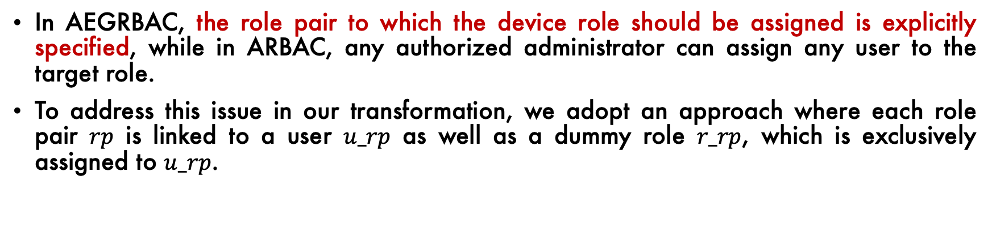
University
of Molise
Transformation
Administrative EGRBAC ARBAC
In AEGRBAC, the role pair to which the device role should be assigned is explicitly specified, while in ARBAC, any authorized administrator can assign any user to the target role.
To address this issue in our transformation, we adopt an approach where each role pair $rp$ is linked to a user $u_rp$ as well as a dummy role $r_rp$, which is exclusively assigned to $u_rp$.

Slide 20
University
of Molise
Theorem
There is a run in AEGRBAC iff there is a run in ARBAC
i
i+1
AEGRBAC
device-role
goal
rp
j
j+1
ARBAC
role target
u

Slide 21

University
of Molise
Our approach
Step 2:
Automatic Analysis
We continue the analysis leveraging existing tools in ARBAC
ERIFIER OF ACCESS CONTROL

Slide 22
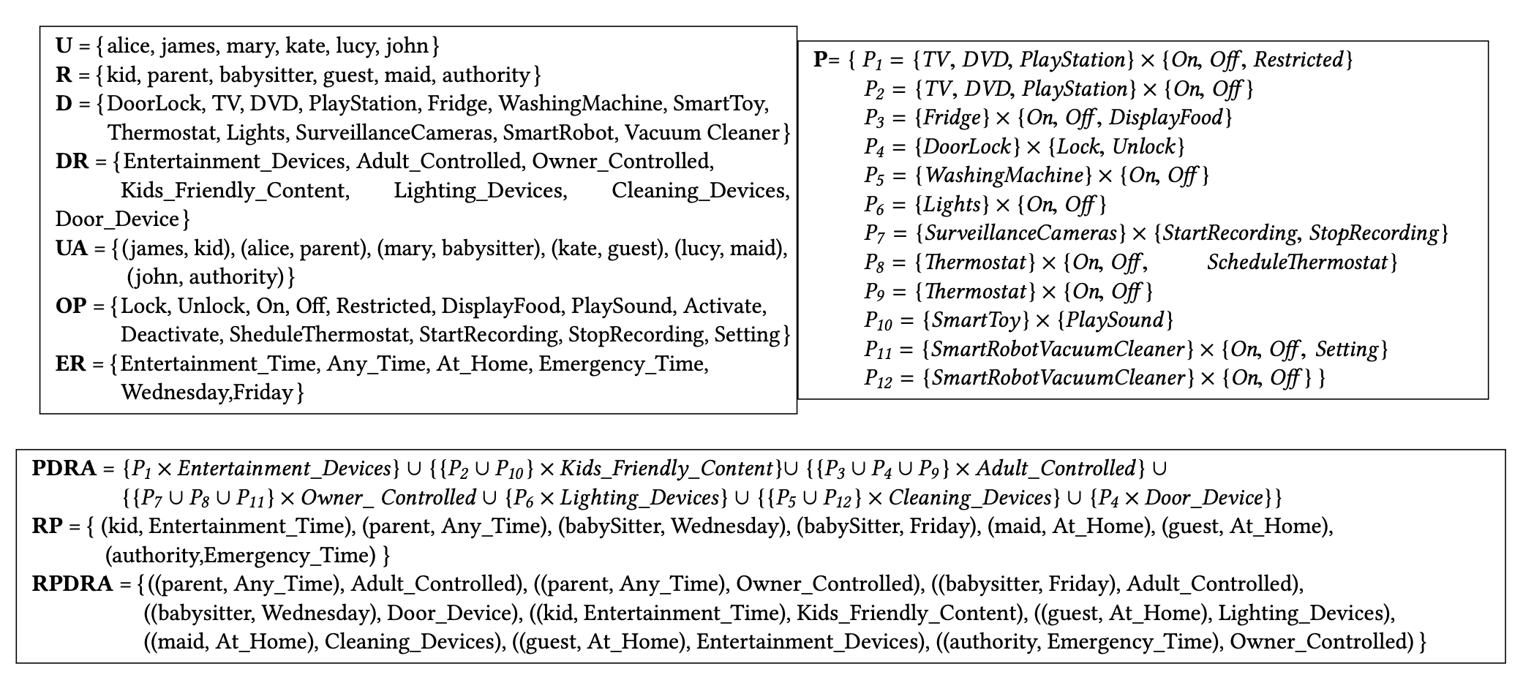
University
of Molise
Experiments

Slide 23
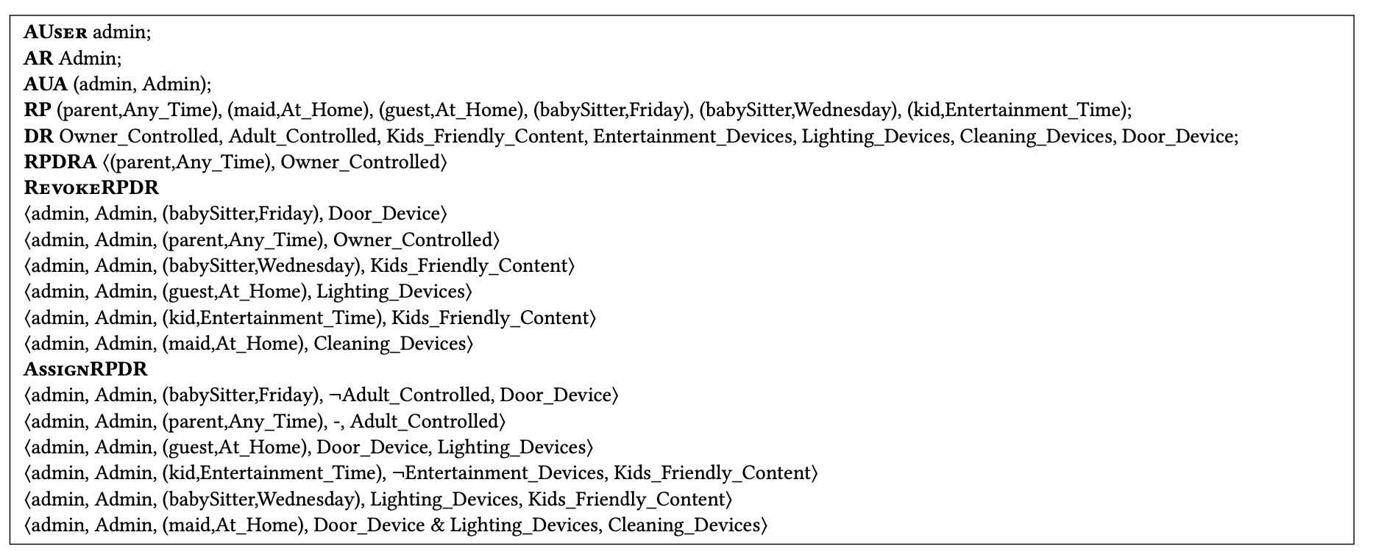
University
of Molise
Experiments
Our full policy has 12 users, 11 roles, 15 role pairs RP, 19 device roles DR and
236 authorization functions

Slide 24
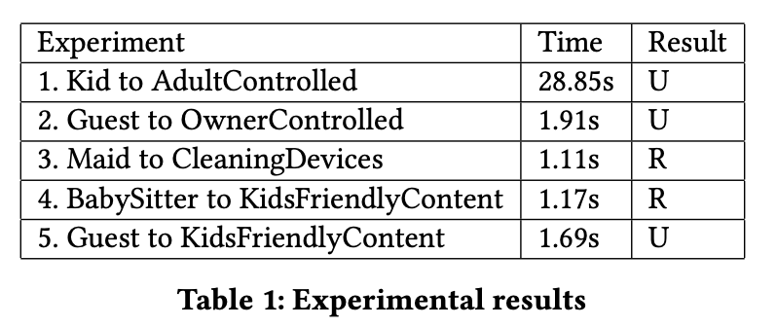
University
of Molise
Experiments
We tested the policy against 21 queries using the tool VAC, the analysis terminated in a few seconds, regardless of whether the target pair was reachable or not

Slide 25


University
of Molise
Future developments
Consider case studies in large-scale scenarios:
e.g., smart building
Consider different underlying tools for the analysis and compare their output/performance

Slide 26
University
of Molise
Thanks for your attention
Roberta Cimorelli Belfiore Anna Lisa Ferrara
r.cimorellibelfio@studenti.unimol.it annalisa.ferrara@unimol.it
SACMAT2023

